Slide 1

Project Phase-II Presentation
On
Machine Learning Based Diabetes Prediction Using Decision Tree-J48
Presented by
Aftab Nadaf
MITU21MTMV0001
Under the Guidance of
Prof. Sandip B. Shrote
Department of Electronics & Communication Engineering
MIT School of Engineering & Science
MIT Art, Design & Technology University, Pune

Slide 2
Introduction:
This project focuses on creating a smart system using Raspberry Pi to predict the chances of someone getting diabetes. By using a special computer skill called machine learning, which allows the computer to learn and make predictions without being taught. The system uses sensors to measure blood glucose and body temperature, and a decision tree algorithm to analyse this data.
The Raspberry Pi, a small computer, receives this information and can switch between sensor and dataset mode. The challenge is converting sensor data into a format the computer can understand. The project offers two ways to collect data, one that continuously collects information and another that uses a keypad to select from different sets of data. The goal is to make a system that helps detect diabetes early, making healthcare management easier. The Raspberry Pi 3 Model B+ as the main controlling component in the project and powerful platform used in this project.
Machine learning is the study of algorithms and mathematical models that computer systems use to improve performance on specific tasks.

Slide 3
Problem Statement:
Early prediction of diabetes for a patient in a non-invasive method with higher accuracy using the Decision Tree J48 algorithm.

Slide 4
Aim of the project
The aim of the project is to develop an automated system using the Raspberry Pi and machine learning techniques, specifically the J48 Decision Tree Algorithm, to accurately predict the risk of diabetes in individuals.

Slide 5
Main Blocks:
Raspberry Pi processor.
Glucosensor
Power supply.
Temperature Sensor
PIC Microcontroller
4X4 Keypad
Selection switch (Data set mode/Sensor Mode)
LCD

Slide 6
Methodology:
Software Used
Microsoft Visual Code for Python Language.
Raspberry pi OS
SCI-KIT Learn Module. (Machine Learning Library)
Hardware Used:
Raspberry PI B+
PIC Microcontroller (8 bit)
Temperature sensor LM35
Glucose sensor
LCD display
Keypad
Selection switch

Slide 7
Methodology: Software
The software architecture of the diabetes prediction system on the Raspberry Pi revolves around a Raspbian Buster 32-bit operating system, a Debian-based Linux distribution tailored for Raspberry Pi devices. Implemented primarily in Python, the system integrates the renowned Scikit-learn (SKlearn) machine learning library for deploying the Decision Tree J48 Algorithm. Data collection is facilitated through glucose and temperature sensors, converting analog outputs to digital with a microcontroller before transmission to the Raspberry Pi.

Slide 8
Methodology: Hardware
Mode of selection, In sensor mode, the Raspberry Pi collects dynamic sensor data, pre-processes the analog information, and reads it for machine learning input. The core of the system involves the Decision Tree J48 Algorithm, utilizing processed data for model training and constructing a decision tree to predict diabetes risk. Data set mode allows users to select different data sets for comparison, and results are displayed on an LCD screen. The system potentially stores and manages data sets on the Raspberry Pi's memory card for future use and reference. This integrated approach forms a comprehensive solution for early diabetes prediction through machine learning on embedded systems.

Slide 9
Methodology: Algorithm
Decision Tree is a Supervised learning technique that can be used for both classification and Regression problems, but mostly it is preferred for solving Classification problems. It is a tree-structured classifier, where internal nodes represent the features of a dataset, branches represent the decision rules and each leaf node represents the outcome.
In a Decision tree, there are two nodes, which are the Decision Node and Leaf Node. Decision nodes are used to make any decision and have multiple branches, whereas Leaf nodes are the output of those decisions and do not contain any further branches.
It is a graphical representation for getting all the possible solutions to a problem/decision based on given conditions.
It is called a decision tree because, similar to a tree, it starts with the root node, which expands on further branches and constructs a tree-like structure.
A decision tree simply asks a question, and based on the answer (Yes/No), it further split the tree into subtrees.

Slide 10
Methodology: Algorithm
Root Node: Root node is from where the decision tree starts. It represents the entire dataset, which further gets divided into two or more homogeneous sets.
Leaf Node: Leaf nodes are the final output node, and the tree cannot be segregated further after getting a leaf node.
Splitting: Splitting is the process of dividing the decision node/root node into sub-nodes according to the given conditions.
Branch/Sub Tree: A tree formed by splitting the tree.
Pruning: Pruning is the process of removing the unwanted branches from the tree.
Parent/Child node: The root node of the tree is called the parent node, and other nodes are called the child nodes.

Slide 11
Block Diagram:
Power
PIC
Raspberry Pi 3
B+
Glucosensor
LCD
Temperature
Sensor
4X4
Keypad
LEDs
Selection
Switch
Fig 1: Proposed Block Diagram

Slide 12
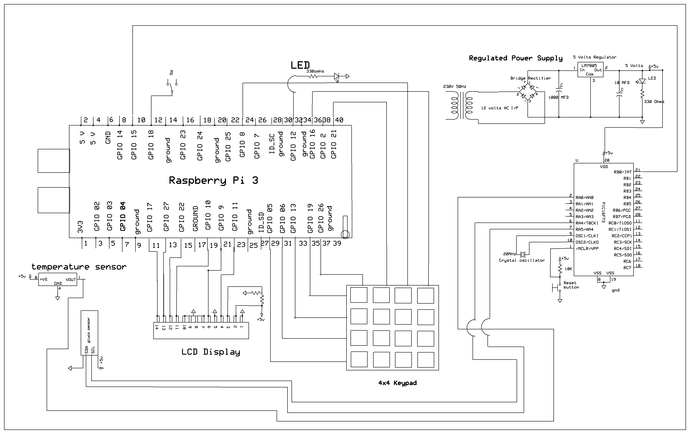
Circuit Diagram:
Fig 2: Circuit Diagram Using Express PCB Software

Slide 13
Raspberry Pi 3 B+
Data Processing and Analysis: The Raspberry Pi is programmed using embedded Linux to handle the data processing and analysis tasks. It runs the necessary software and algorithms to process the sensor data and make predictions about the chances of diabetes.
Interface with PIC microcontroller: The Raspberry Pi communicates with the PIC microcontroller, which is connected to the sensors. It receives the digital data from the PIC microcontroller, which represents the glucose levels and temperature readings obtained from the sensors.
Decision Tree J48 Algorithm: The Raspberry Pi utilizes the scikit-learn library, specifically the J48 algorithm, to perform the diabetes prediction. The digital data received from the PIC microcontroller, along with the dataset values entered by the user through the 4x4 keypad, is used as input for the decision tree algorithm.

Slide 14
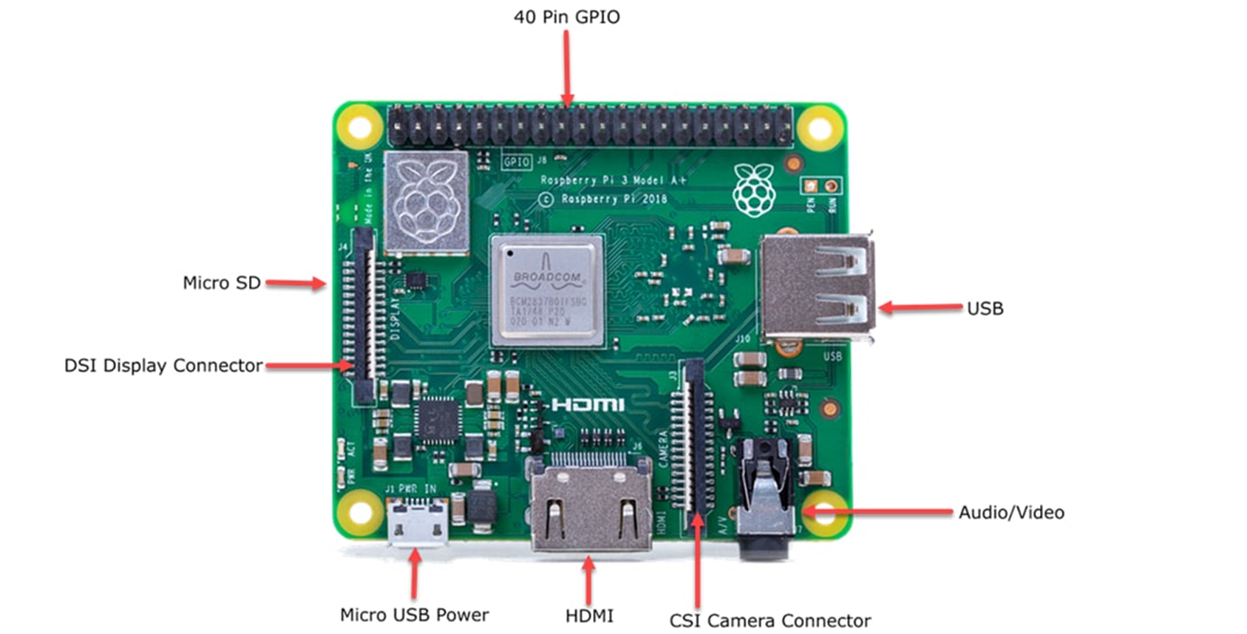
Raspberry Pi 3 B+
Fig 3: Raspberry Pi

Slide 15
Glucosensor:
NIR (Near-Infrared) glucosensor refers to a type of sensor that uses near-infrared light to measure glucose levels in a non-invasive or minimally invasive manner. It is designed to provide a convenient and real-time monitoring solution for individuals with diabetes, eliminating the need for traditional finger-prick blood glucose testing.
The NIR glucosensor works based on the principle that near-infrared light can interact with glucose molecules in the human body. Glucose has specific absorption properties in the near-infrared spectrum, allowing the sensor to measure the concentration of glucose in the blood.
The sensor typically consists of a light source that emits near-infrared light, a detector to measure the intensity of the reflected or transmitted light to convert the measured light signals into glucose readings.

Slide 16
Glucosensor:
To use a NIR glucosensor, the sensor is usually placed on the skin, such as on the fingertip. The near-infrared light is then directed onto the skin, and the reflected or transmitted light is analyzed by the sensor. By analyzing the interaction between the light and glucose molecules, the sensor can estimate the glucose concentration in the blood.
Overall, the NIR optical technique works by NIR light through the fingertip, measuring how much light is absorbed by the glucose in the blood, and using that information to determine the glucose concentration.

Slide 17
Temperature sensor
A sensor is a device that measures a physical quantity and converts it into a signal which can be read by an observer or by an instrument.
LM35 is a precision temperature sensor integrated circuit (IC) that provides an analog voltage output proportional to the temperature it measures. It is commonly used in various applications to measure temperature accurately. The LM35 sensor operates on the principle of the linear relationship between temperature and voltage
The LM35 temperature sensor can be interfaced with microcontrollers or other electronic devices to measure and monitor temperature in various systems. Its simplicity, accuracy, and wide temperature range make it a popular choice in applications such as weather monitoring, environmental control systems, industrial automation, medical devices, and more.

Slide 18
Microcontroller
The PIC microcontroller is used as an intermediary device between the sensors and the Raspberry Pi. Its main purpose is to interface with the sensors and convert the analog signals from the sensors into digital signals that can be easily understood by the Raspberry Pi.
The PIC microcontrolleris connected to the sensors, specifically the NIR glucose sensor and the temperature sensor. These sensors provide analog outputs, which means they generate continuous voltage signals that represent the measured values. However, the Raspberry Pi does not natively support analog inputs, so the PIC microcontroller is used to bridge this gap.
The PIC microcontroller has built-in analog-to-digital converters (ADC) that can convert the analog signals from the sensors into digital values. It reads the analog signals from the sensors and converts them into digital data that represents the glucose levels and temperature readings.

Slide 19
keypad
In this project, a keypad is used as a user interface to input values into the system. The keypad is a 4x4 matrix of buttons, similar to the numeric keypad on a calculator or a telephone.
The Raspberry Pi, which is the main controlling part of the project, is connected to the keypad. The Raspberry Pi has pins that can be configured as input pins to read the signals from the keypad buttons.
Once the user has entered all the required dataset values, the Raspberry Pi receives and processes this data along with the sensor data obtained from the PIC microcontroller. The decision tree algorithm then uses this combined data to predict the chances of diabetes for the patient.

Slide 20
LCD
The LCD is connected to the Raspberry Pi, which is the main controlling part of the project. The Raspberry Pi has GPIO (General Purpose Input/Output) pins that can be used to communicate with external devices such as the LCD.
After the prediction process is performed using the decision tree algorithm and the input data, the Raspberry Pi generates the output result. This result, which indicates the predicted chances of diabetes for the patient, is then sent to the LCD for display.
The displayed information on the LCD can include the predicted chances of diabetes, along with any other relevant details or instructions for the user, the LCD serves as an output device in this project, providing a visual display of the prediction results or information to the user.

Slide 21
Flowchart:
Start of the system
Initialize System and Load Libraries (e.g., scikit-learn, RPi.GPIO)
Based on User Input, Choose Dataset or Sensor Mode
If Sensor Mode: Collect Real-time Sensor Data, Predict Diabetes Risk using Trained Model, and Display Result on LCD Screen
If Data set Mode: Allow User to Choose from Data Sets (Stored or Provided), Load Data, and Display Result of Decision Tree Prediction on LCD
Load Kaggle-derived Training Dataset (External or Local Source, e.g., CSV file)
Collect User Input from 4x4 Keypad or Mode Selection from Switches
Preprocess Data (Handle Missing Data, Normalize Features, Split into Train/Test)
Read Data from Sensors (Temperature, Glucose) through PIC Microcontroller
End of the System
Train J48 Decision Tree Algorithm using scikit-learn decision tree classifier
Initialize Raspberry Pi, PIC Microcontroller, and Interface with Sensors and User Input

Slide 22
Results:
Data Range:
Defined six distinct types of outcomes based on ranges of glucose levels. Here's an elaboration on each outcome and its associated glucose level range in Milligrams per decilitre (mg/dL):
Excellent (0-90):Individuals falling within the glucose level range of 0 to 90 mg/dL are classified as Excellent. This range typically represents a healthy blood sugar level.
Normal (90-120):This range is considered normal and indicates a stable blood sugar level.
Borderline (120-130):Individuals with glucose levels in the range of 120 to 130 mg/dL are classified as Borderline.
Prediabetes (130-150):The Prediabetes category includes individuals with glucose levels ranging from 130 to 150 mg/dL. This range signifies an elevated blood sugar level that may precede the onset of diabetes.
Diabetes (150-180):This range indicates a higher and potentially unhealthy blood sugar level requiring medical attention.
Dangerous (180 and above):This range represents a critical condition, and individuals falling into this category may be at risk of severe health complications. Urgent medical intervention is typically required

Slide 23
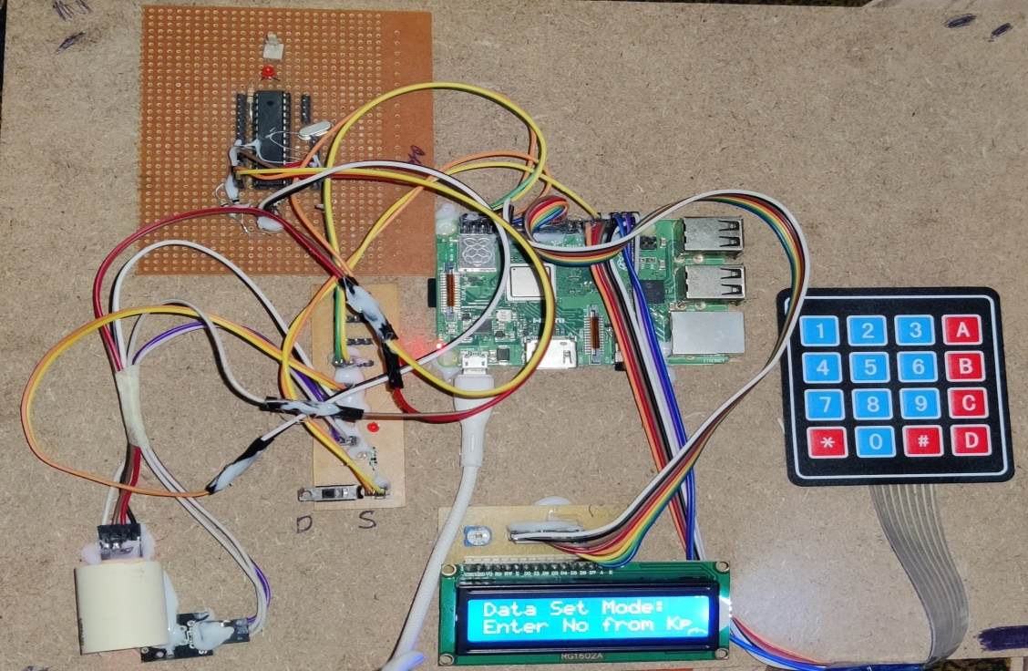
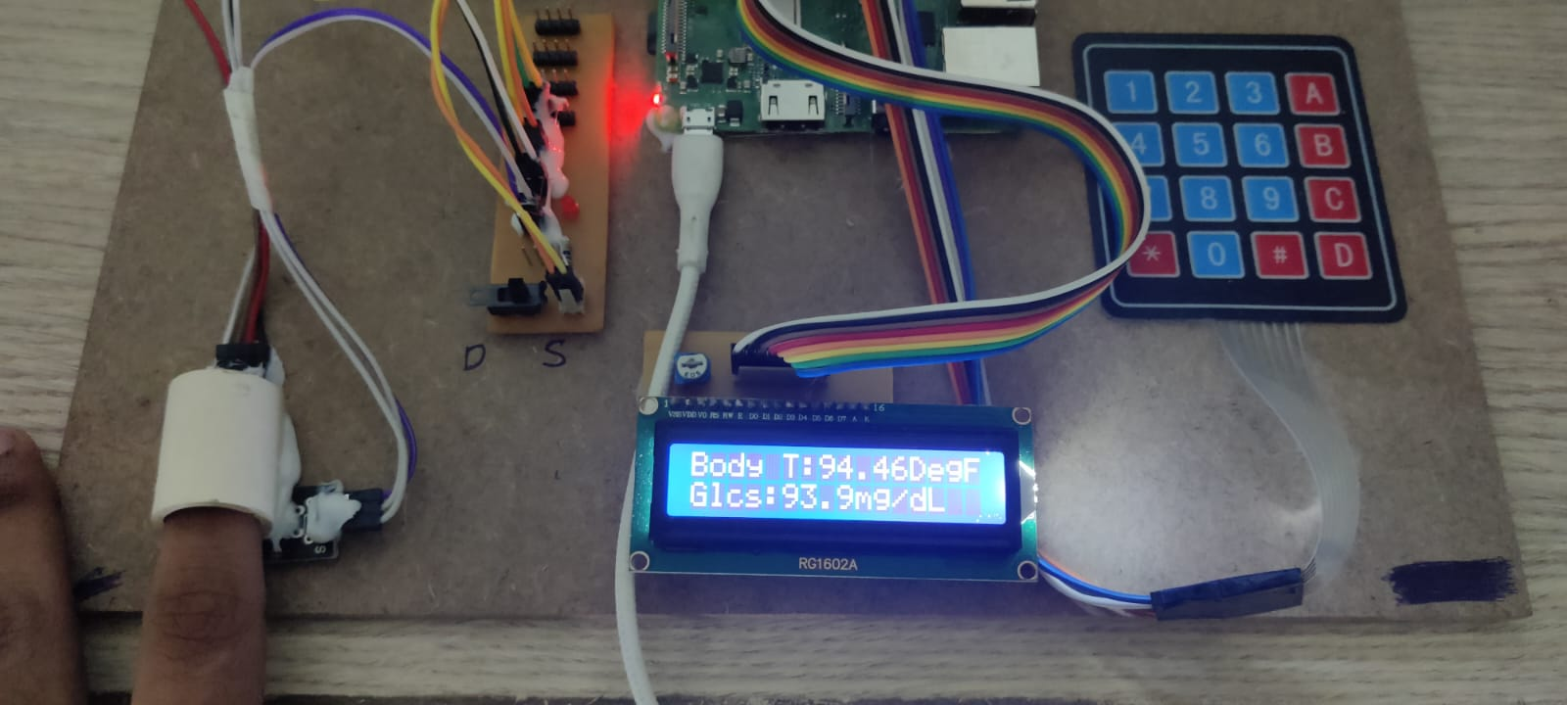
Results:
Fig.5 Overall Kit.
Fig.6 Body temperature and glucose level of the user.

Slide 24
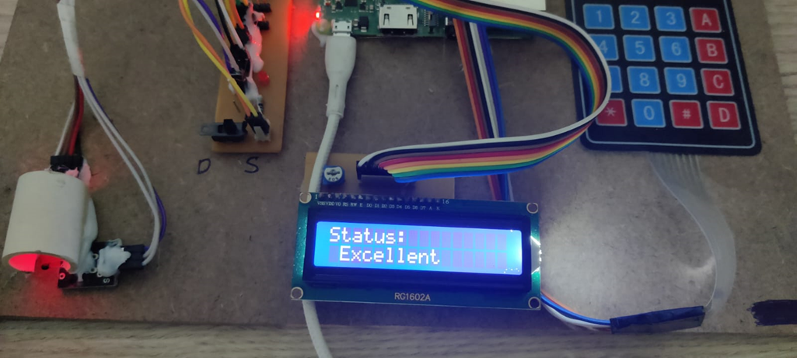
Results:
Fig.7 Prediction of the disease.

Slide 25
Results:
Outcome | Glucose Level (mg/dL) | Temperature Level (°F)
Excellent | 85 | 97.7
Normal | 115 | 99.0
Borderline | 125 | 98.2
Prediabetes | 140 | 99.5
Diabetes | 160 | 98.6
Dangerous | 185 | 100.0
Excellent | 78 | 97.3
Normal | 105 | 99.1
Borderline | 132 | 98.1
Prediabetes | 155 | 99.7
Fig.8 Patient Data
Fig.9. Plotted Graph

Slide 26
Conclusion
The project highlights the importance of machine learning in healthcare and its potential to assist healthcare professionals in making informed decisions regarding diabetes management. By providing early predictions, healthcare providers can implement timely interventions and treatments, ultimately improving patient outcomes and quality of life.
Through the utilization of the Decision Tree algorithm, the system is capable of early prediction of diabetes for patients with higher accuracy. By leveraging machine learning techniques, the project aids in identifying potential cases of diabetes at an early stage, enabling timely intervention and treatment.

Slide 27
References:
[1] Faezeh Ensan, Mohammad Hossien Yaghmaee, Ebrahim Bagheri, “FACT: A new Fuzzy Adaptive Clustering Technique”, The 11th IEEE Symposium on Computers and Communications, Sardinia, 26-29 June2006
[2] JIanchao Han, Juan C.Rodriguze, Mohsen Beheshti, "Diabetes Data Analysis and Prediction model discovery" IEEE, Second International conference on future generation communication and networking, pp 96-99,2011
[3] Asma A.Aljarullah, "Decision tree discovery for the diagnosis type 2 diabetes" IEEE, International conference on innovation in information technology, pp 303-307, 2011
[4] Huang, Feixiang; Wang, Shengyong; Chan, ChienChung, "Predicting disease by using data mining based on healthcare information system," Granular Computing (GrC), 2012 IEEE International Conference on , vol., no., pp.191,194, 11-13 Aug. 2012
[5] Pradeep, K. R., & Naveen, N. C. 2016. Predictive analysis of diabetes using J48 algorithm of classification techniques In Contemporary Computing and Informatics (IC3I), IEEE.

Slide 28
[6] Dhomse Kanchan 2016 study of machine laerningAlgorithms for Special Disease Prediction using Principal of Component Analysis, in: 2016 International Conference on Global Trends in Signal Processing, Information Computing and Communication, IEEE.
[7] Rani, A. Swarupa, and S. Jyothi. "Performance analysis of classification algorithms under different datasets." In Computing for Sustainable Global Development (INDIACom), 2016 3rd International Conference on, pp. 1584-1589. IEEE, 2016.
[8] Aishwarya, Gayathri, Jaishankar, “A Method for Classification Using Machine Learning Technique for Diabetes”, International Journal of Engineering and Technology2013.

Slide 29
Thank You

